Slide 1

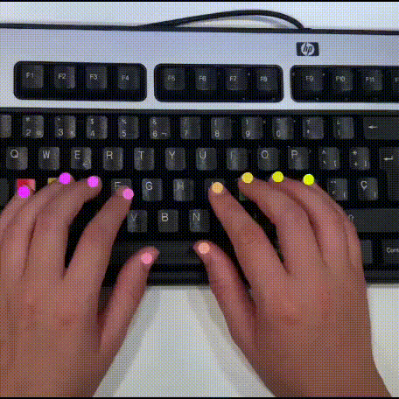
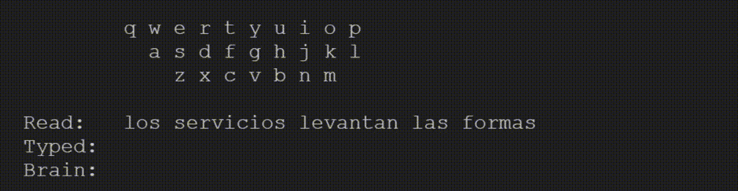


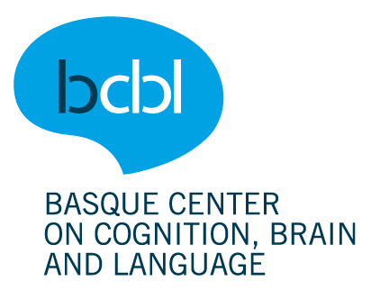
Brain-to-Text Decoding: A non-invasive approach via Typing
Jarod Lévy
Stéphane d’Ascoli
META FAIR
Jean-Rémi King
École Normale Supérieure
META FAIR
Thomas Moreau
INRIA Saclay
MIND

Slide 2
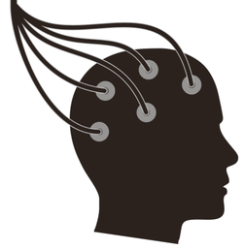

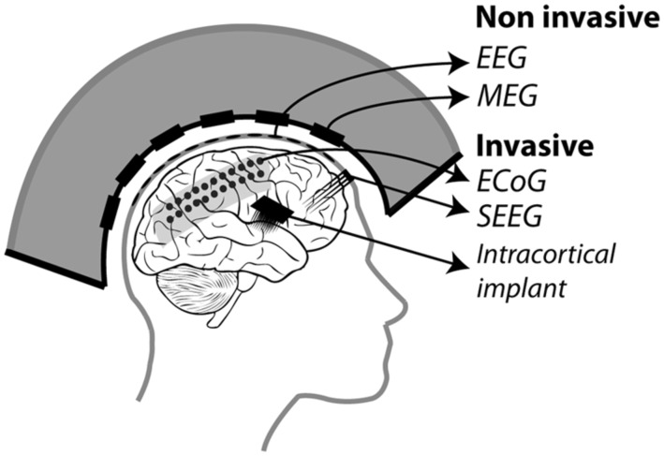
Brain-Computer Interfaces (BCI)
Signal acquisition (EEG, MEG, fMRI…)
Signal processing (machine learning, deep learning…)
BCI applications
Feedback
…
Robotic arms
Emotion recognition
Task…
Wheelchair
Speller and speech generation
Image from Astrand et al.

Slide 3
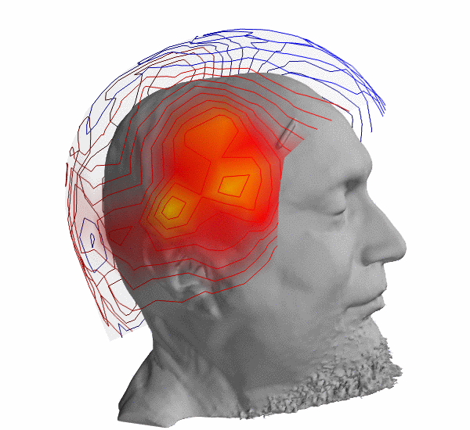

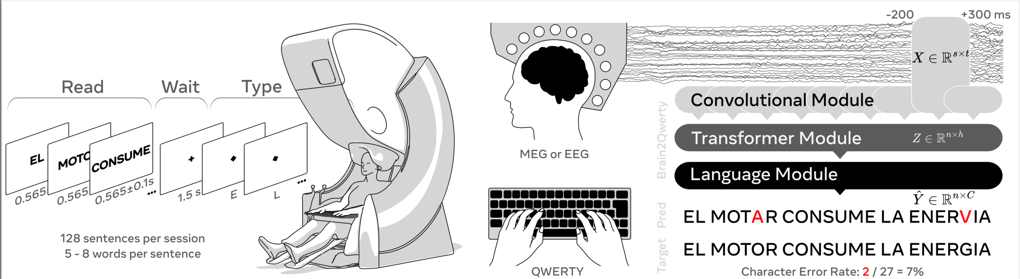

Problem Definition
Deep Learning
Pipeline for Classification
Signal acquisition (EEG and MEG)
Text
Spanish Language
20 participants
~1 hour/participants
29 different keystrokes
Non-invasive methods are not yet able to properly decode communication and language.
Typing is well suited for not creating large artifacts.
Very little literature for typing task with EEG and MEG.
It’s very difficult : Crell & al. (2024) achieves 75.8% error rate with a 10 letters restriction on EEG signals.

Slide 4
Problem Definition
Deep Learning
Pipeline for Classification
Signal acquisition (MEG)
Text
What is X?
MEG/EEG recordings
Temporal Series
Minimal Preprocessing
0.5s window
Dimension: (B, C, T)
Classification Problem
Cross Entropy Loss
What is Y?
Correct Keystroke

Slide 5
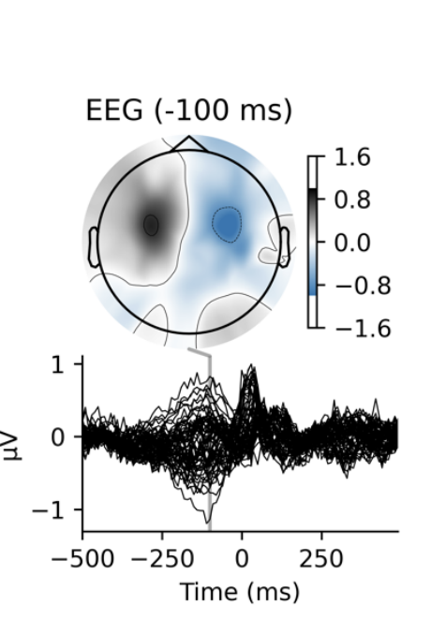
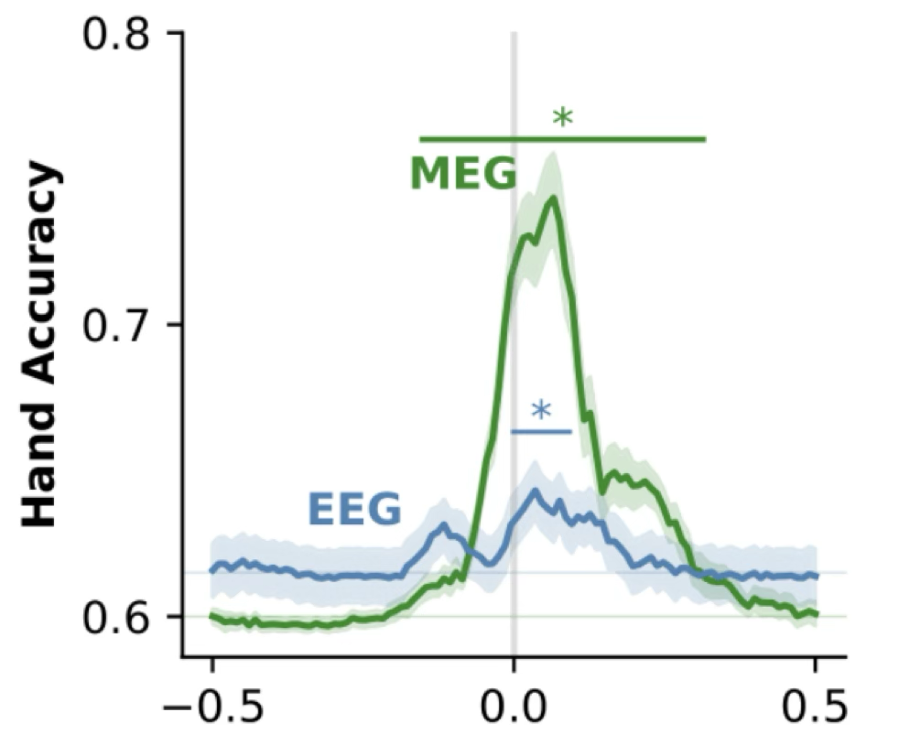
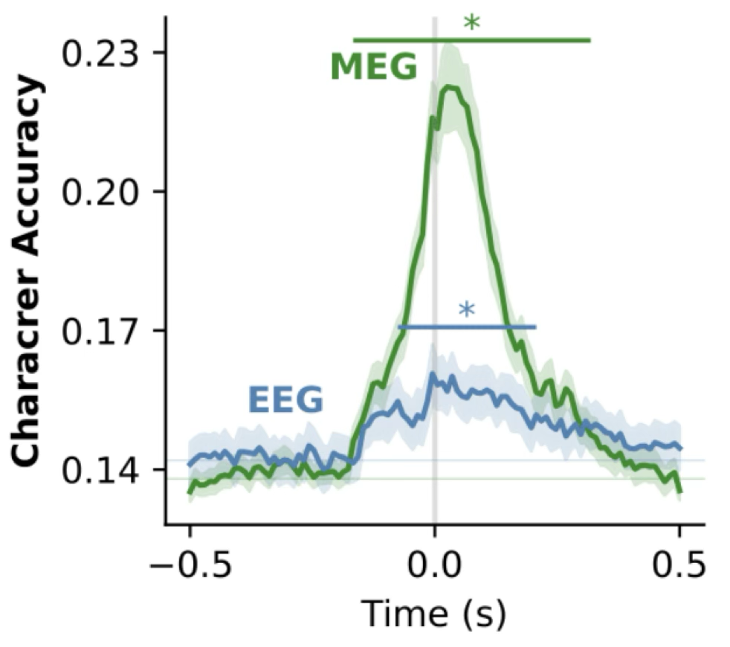
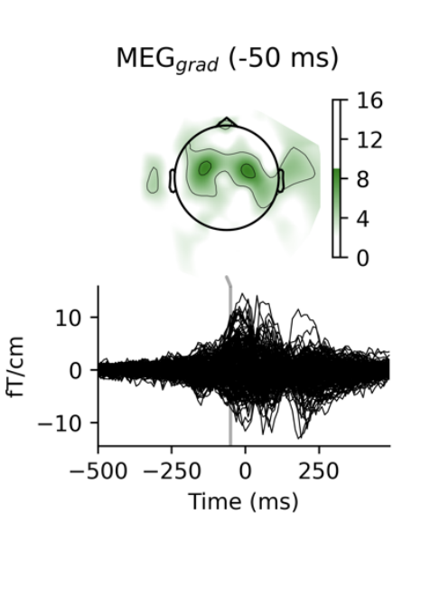
Any Signal ?
Keystrokes can be linearly decoded better than chance,
but accuracies are very low

Slide 6
Brain2Qwerty Pipeline

Slide 7
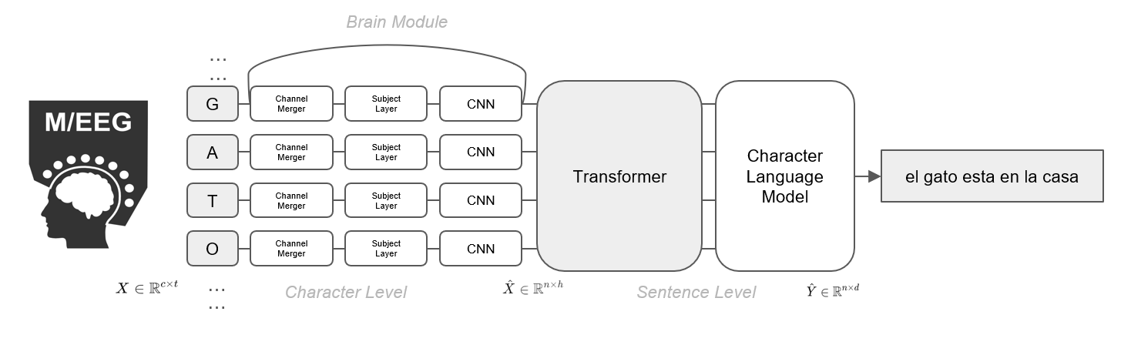
Brain2Qwerty Pipeline

Slide 8
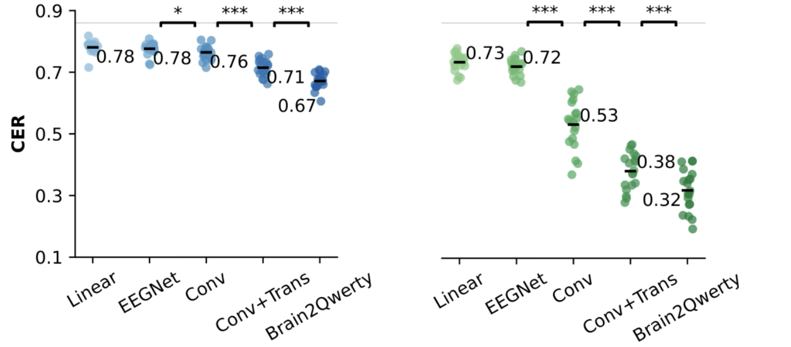
Model Performance and Ablation Studies
The Lower
The Better
EEG: 1/3 characters correct MEG: 2/3 characters correct (up to 80% for best subjects)
Notes:
Explain in 2-3 minutes your current work on preprocessing.

Slide 9
Decoded Sentence Showcase
Sentence: “las teorias reducen los numeros”
MEG
Decoding…
Brain2Qwerty
las teorias reducen
los numeros
las geoolas redicen
los numeios
las tangpas re udnndl slindiiis
EEG
CER= 0.0
CER= 0.516
Typing...
CER= 0.161
las teorias reducen los numeros

Slide 10
Decoded Sentence Showcase
Sentence: “las condiciones favorecen los desarollos”
MEG
Decoding…
Brain2Qwerty
las vimvisiomnes estirctan los decarroilos
las condicion es extienden los desarrollos
EEG
CER= 0,171
Typing...
CER= 0.317
las comdiciomes favorecen los desarollos
Notes:
Median Example

Slide 11
Decoded Sentence Showcase
Sentence: “las controversias cierran el paso”
MEG
Decoding…
Brain2Qwerty
las controversias cierran el paso
EEG
Typing...
CER= 0.0
las controversias cierran el paso

Slide 12
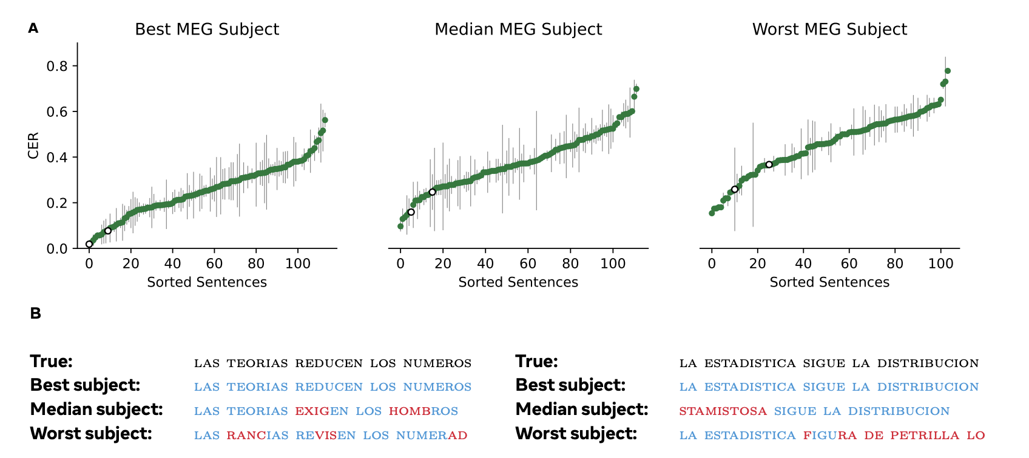
Model Performance Across Unseen Sentences

Slide 13
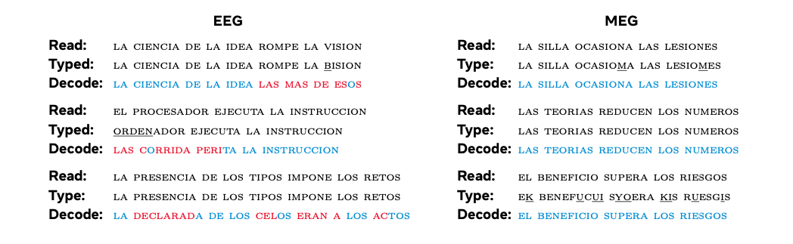
Best Examples EEG vs MEG

Slide 14
A Companion Study -- Zhang. et al (2025)

Slide 15
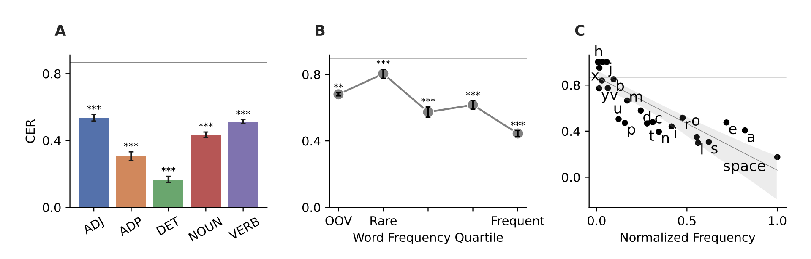
Character and Word Level Performance

Slide 16
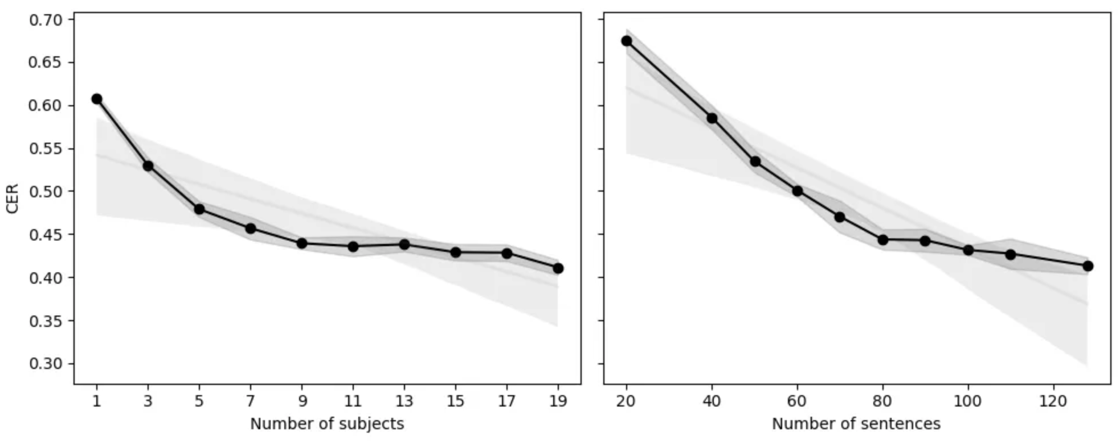
Scaling Laws

Slide 17
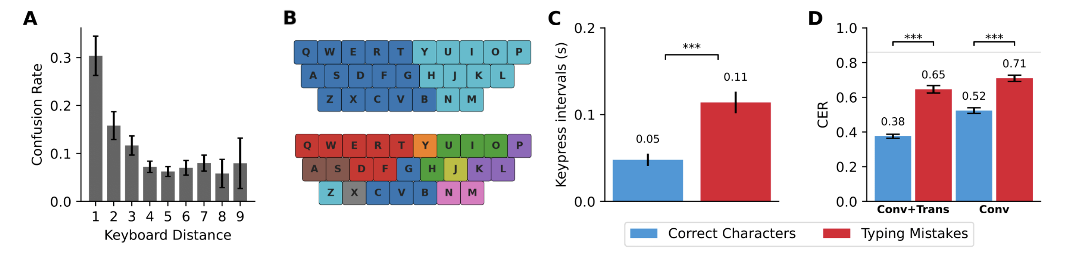
We Are Mostly Decoding Motor Responses

Slide 18
But Do We Decode Only Hand Position?
Sentence: “el beneficio supera los riesgos”
MEG
Decoding…
Brain2Qwerty
el beneficio supera
los riesgos
EEG
Typing...
CER= 0.0
el benefucui syoera kis ruesgis

Slide 19
But Do We Decode Only Hand Position?

Slide 20
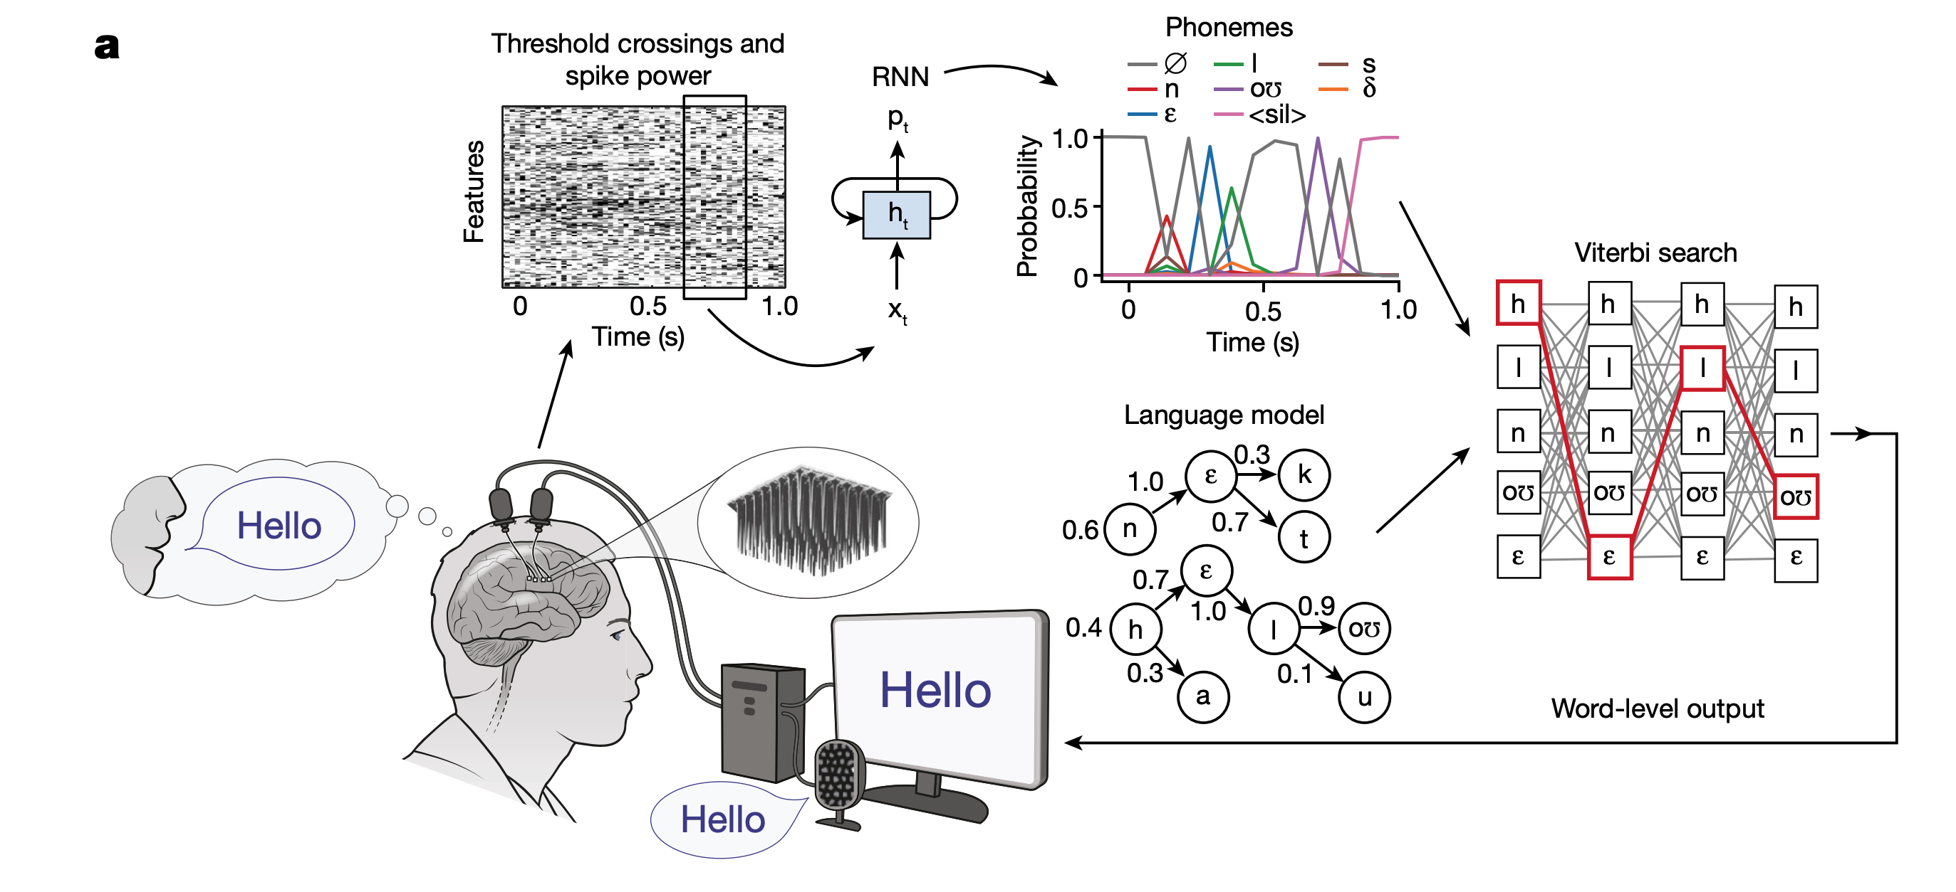
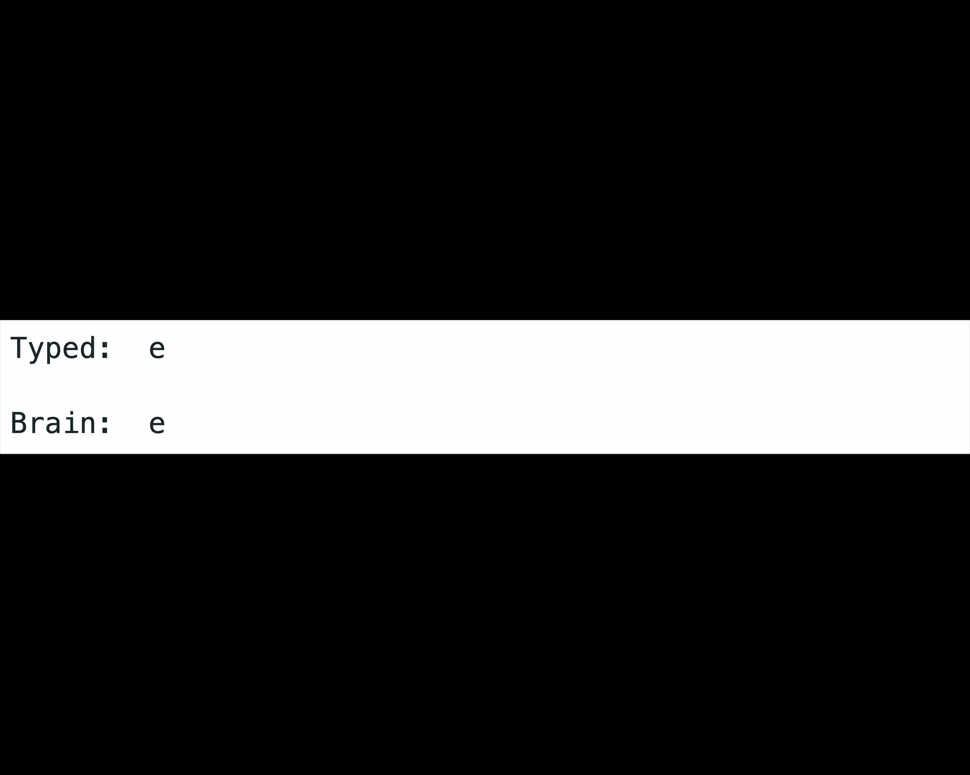
Achievements and Future Directions
Achievements
Unseen performance using noninvasive tools for a production task.
Insights on why it is interesting to record from the scalp directly (and maybe not the wrist) → Cognition access
Next Steps
From synchronous to asynchronous: remove button onset dependency.
Continuation of the data collection: scaling laws are verified.
End-to-end approach with pretrained language models.
Willett et al. (2023)

Slide 21
Thank You !

Slide 22
References
1. Défossez, A., Caucheteux, C., Rapin, J. et al. Decoding speech perception from non-invasive brain recordings. Nat Mach Intell 5, 1097–1107 (2023). 2. Caucheteux, C., Gramfort, A. & King, JR. Evidence of a predictive coding hierarchy in the human brain listening to speech. Nat Hum Behav 7, 430–441 (2023). 3. Sato, Motoshige, et al. "Scaling Law in Neural Data: Non-Invasive Speech Decoding with 175 Hours of EEG Data." (2024). 4. Sivakumar, V., Seely, J., Du, A. et al. “emg2qwerty: A Large Dataset with Baselines for Touch Typing using Surface Electromyography.” (2024). 5. Hao, Yaoyao, et al. "Decoding imaginary handwriting trajectories of multi-stroke characters for universal brain-to-text translation." (2024). 6. D’Ascoli, S., Bel, C., Rapin, J. et al. “Decoding individual words from non-invasive brain recordings.” (2024). 7. Shao, Jie, et al. "Is normalization indispensable for training deep neural network?." Advances in Neural Information Processing Systems 33 (2020). 8. Crell, Markus R., and Gernot R. Mueller-Putz. "Towards EEG-to-Text: Handwritten Character Classification via Continuous Kinematic Decoding." (2024). 9. Lawhern, Vernon J., et al. "EEGNet: a compact convolutional neural network for EEG-based brain–computer interfaces." (2018). 10. Feit, Anna Maria, Daryl Weir, and Antti Oulasvirta. "How we type: Movement strategies and performance in everyday typing." Proceedings of the 2016 chi conference on human factors in computing systems. 2016.

